Slide 1
Zomato Data Analytics Project
Group 1
1) Rahul Vishnu Shewale 2) Madamanchi Bharath 3)Aasheesh Dashore
4) Kirankumar Mudhol 5) D Yuva Kiran 6) Rakesh A P 7) B. Santhosh Kumar

Slide 2


Introduction
The Zomato Restaurant Data Analytics Project focuses on analyzing restaurant performance, customer behavior, and service trends using real-world dataset insights.
This project aims to:
Analyze restaurant distribution across countries and cities
Study customer ratings and voting patterns
Examine pricing strategies (Average Cost for Two)
Evaluate online delivery and table booking services
Identify popular cuisines and growth trends
By transforming raw data into meaningful insights, this project helps demonstrate how data analytics can support better business decision-making in the food and hospitality industry.

Slide 3
DATA OVERVIEW
The Zomato Restaurant Dataset contains detailed information about restaurants listed
across multiple countries and cities.
🔹 Key Features of the Dataset:
Restaurant Name – Unique identity of each restaurant listed on the platform.
City & Country – Useful for analyzing geographical distribution and regional
market presence.
Cuisines – Lists the types of food offered (e.g., Indian, Chinese, Italian, Fast
Food).
Average Cost for Two – Helps categorize restaurants into Low, Medium, and High price segments.
Aggregate Rating – Weighted average rating given by customers (0–5 scale).
Votes – Total number of users who rated the restaurant
Has Online Delivery – Whether the restaurant provides online food delivery service.
Has Table Booking – Indicates availability of reservation facility.

Slide 4
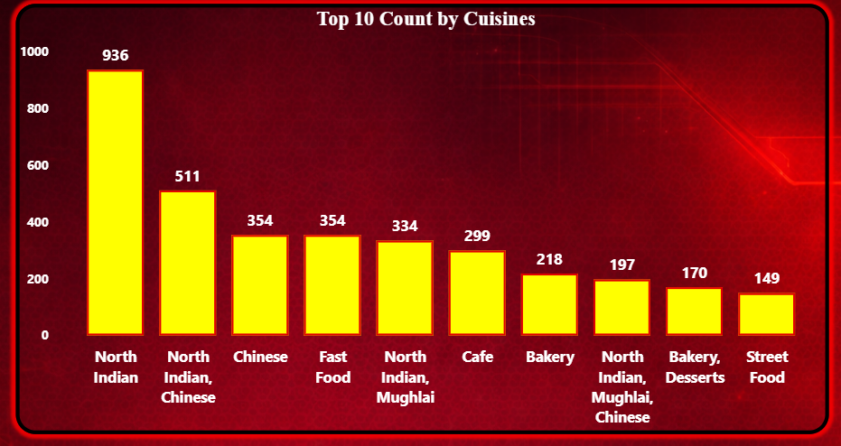
Top 10 Count by Cuisines
The analysis of the Top 10 cuisines reveals that North Indian cuisine dominates the dataset with the highest restaurant count (936), indicating strong customer preference and market demand.
• The second most popular cuisine category is North Indian Chinese (511), followed by Chinese (354) and Fast Food (354), highlighting the popularity of both traditional and quick-service dining options.
• Mid-level cuisines such as Cafe (299) and Bakery (218) show steady presence, reflecting growing urban lifestyle trends.
• Overall, the dataset suggests that Indian regional cuisine forms the backbone of restaurant distribution, especially in high-density cities.

Slide 5
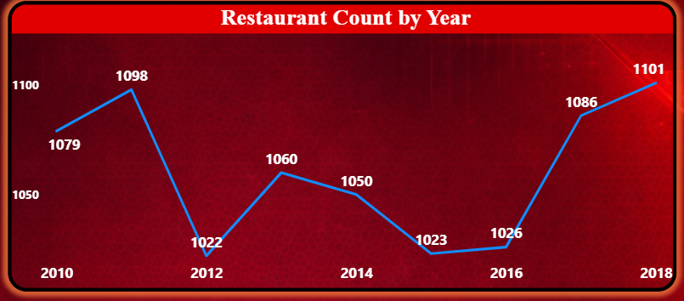
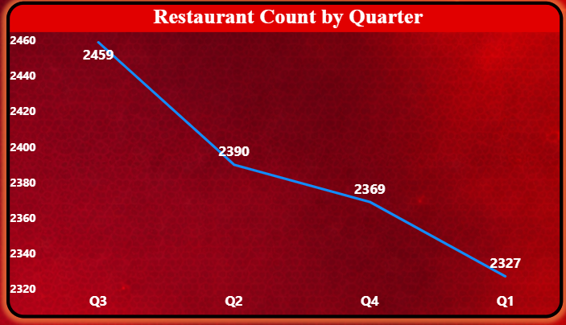
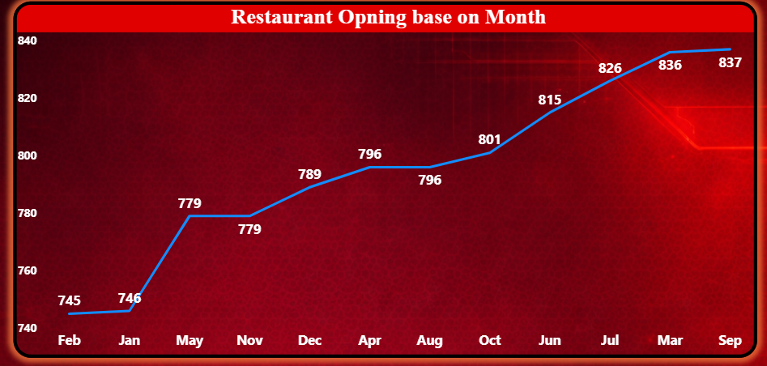
Number of Restaurants opening based on Year, Month, Quarters
Restaurant openings show overall growth after a dip in 2012, with peak expansion in 2018.
Q3 and mid-year months record the highest activity, indicating seasonal expansion trends.

Slide 6
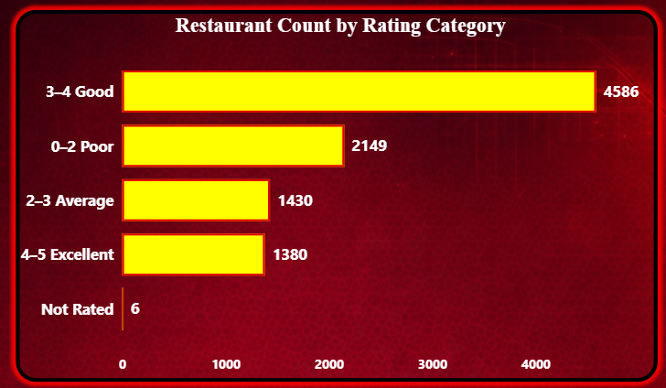
Count of Restaurants by Average Rating –
The majority of restaurants fall in the 3–4 rating category (4586), indicating generally good customer satisfaction.
A significant number of restaurants are in the 0–2 rating group (2149), showing areas that require quality improvement.
The 2–3 rating category (1430) represents average-performing restaurants.
Only 1380 restaurants fall under the 4–5 (Excellent) category, suggesting limited high-performing establishments.

Slide 7
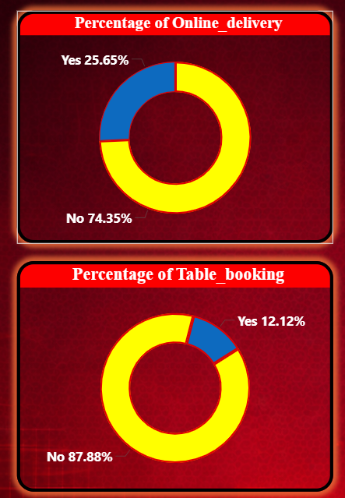
Percentage of Restaurants based on "Has Table booking.”
& “Has Online delivery."
Has Online Delivery :
25.65% of restaurants provide online delivery, which is higher than table booking adoption.
Has Table Booking:
Only 12.12% of restaurants offer table booking, showing very low adoption.
The majority (74.35%) still do not offer delivery services.
Reflects a growing but not fully digital food delivery market.
The majority (87.88%) operate without reservation facilities.
Indicates that most restaurants focus more on walk-in or delivery-based services rather than premium dine-in experience.

Slide 8
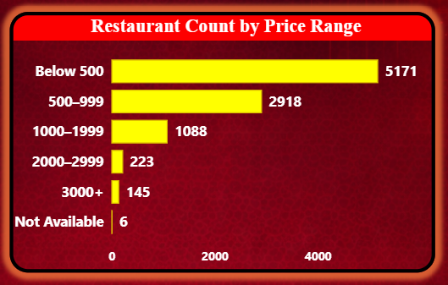
Restaurant Count by Price Range:
The majority of restaurants (5171) fall under the Below 500 price range, indicating strong dominance of low-cost dining.
The 500–999 segment (2918) represents the second largest group, showing high demand for affordable mid-range options.
Higher price categories (1000+) have significantly fewer restaurants, indicating limited premium dining presence

Slide 9
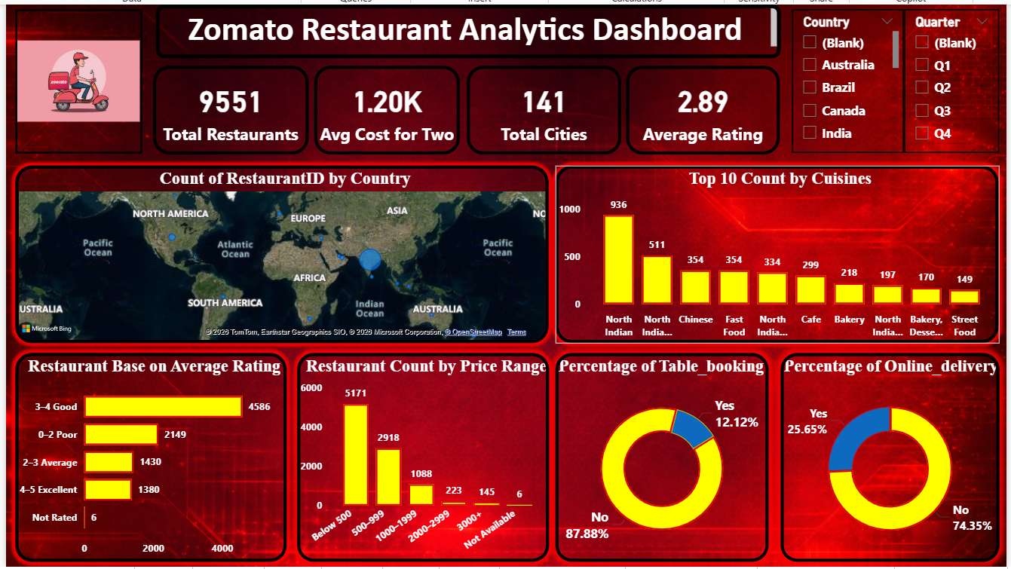

Slide 10
Recommendations
Focus on Quality Improvement
A large number of restaurants fall in the 0–2 rating category.
Restaurants should improve service quality, hygiene, and customer experience.
Only 25.65% of restaurants offer online delivery.
Expanding delivery partnerships can increase revenue and customer reach.
Majority of restaurants operate in the Below 500 and 500–999 range.
The premium segment has a growth opportunity in metro cities.
Expand Online Delivery Services
Strengthen Mid-Range Pricing Strategy

Slide 11
Conclusion
The analysis of the Zomato restaurant dataset provides valuable insights into restaurant distribution, pricing strategy, customer ratings, service adoption, and growth trends.
Online delivery adoption is growing, while table booking remains limited.
Restaurant openings follow a seasonal and mid-year growth trend.
Overall, this project demonstrates how data analytics can transform raw data into actionable business insights, supporting strategic decision-making in the food and hospitality industry.

Slide 12
Thank You

